Slide 1
FLEET MANAGEMENT SYSTEM
Managing fleet of Buses Proficiently
TIKANI RUTH ITA
051298

Slide 2
PROBLEM STATEMENT
The manual system of managing a bus system is the dominating approach used by most bus companies which is ineffective and in the long-run costly.

Slide 3
PROBLEM STATEMENT (cont)
There is a lack of reliable and extensive fleet management system for bus companies that manage buses with respect to reliable record keeping, maintenance, servicing, licensing.

Slide 4
SHORT-COMINGS TO BE ERADICATED
Lack of Accountability among the personnel handling the buses
Poor record keeping of company assets (Buses)
Negligence & laxity on laws and regulations of licensing and insurance
Poor maintenance of the vehicle

Slide 5
SOLUTIONS
Create a user-friendly System
Automate the manual approach of managing the fleet of buses
Record relevant data on a secure database
Have service schedulers for the buses with reminder alerts

Slide 6
SOLUTIONS
Generate reports that will prove necessary for management and decision making
Calculates depreciation value for buses to sell out buses
Have a record of Suppliers in the database

Slide 7
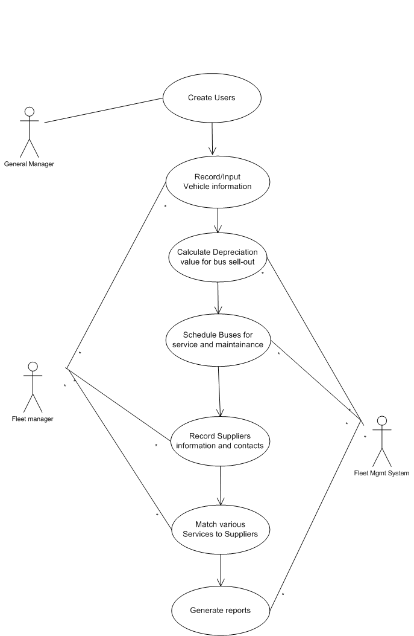
USE-CASE

Slide 8
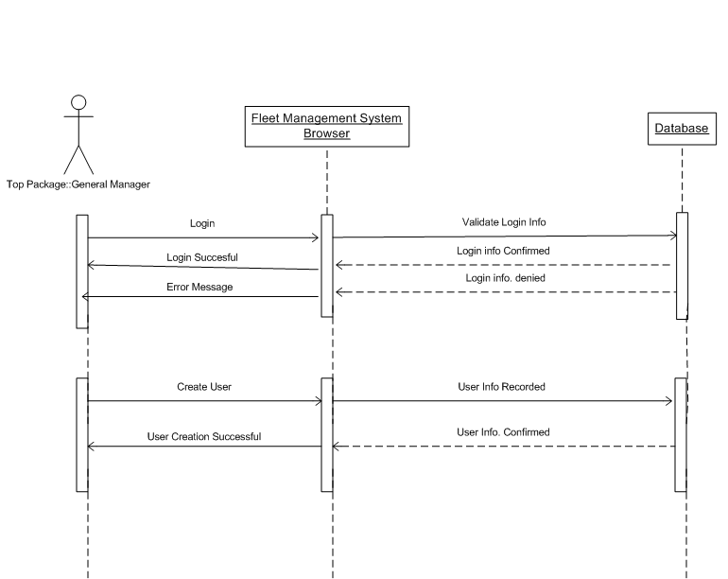
SEQUENCE DIAGRAM

Slide 9
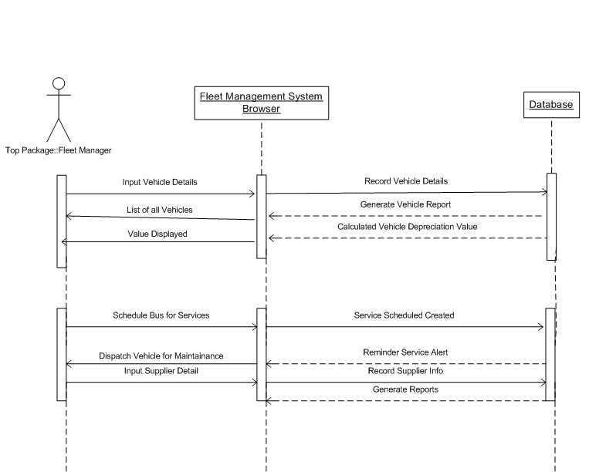
SEQUENCE DIAGRAM

